Slide 1
The economic outlook
Remarks by Governor Gabriel Makhlouf
11 June 2020

Slide 2
Developments in the euro area economy
Sources: Eurostat, IHS Markit. Notes: the Purchasing Managers’ Index is a monthly survey of producers regarding a variety of economic conditions compiled by IHS Markit. It is split into a services and manufacturing component. Values below 50 show a contraction.

Slide 3
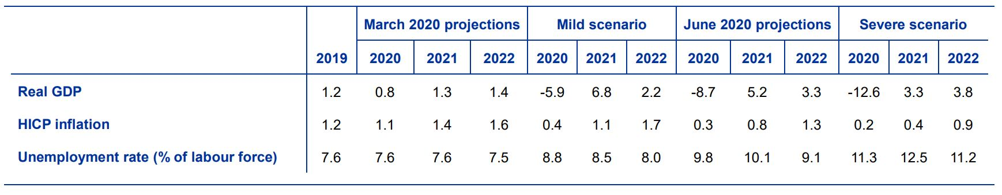
Economic outlook for the euro area
Sharp downward revisions in the macroeconomic projections since March for the period 2020 – 2022.
Source: Eurosystem staff macroeconomic projections for the euro area, June 2020. Real GDP and HICP inflation: annual percentage changes.

Slide 4
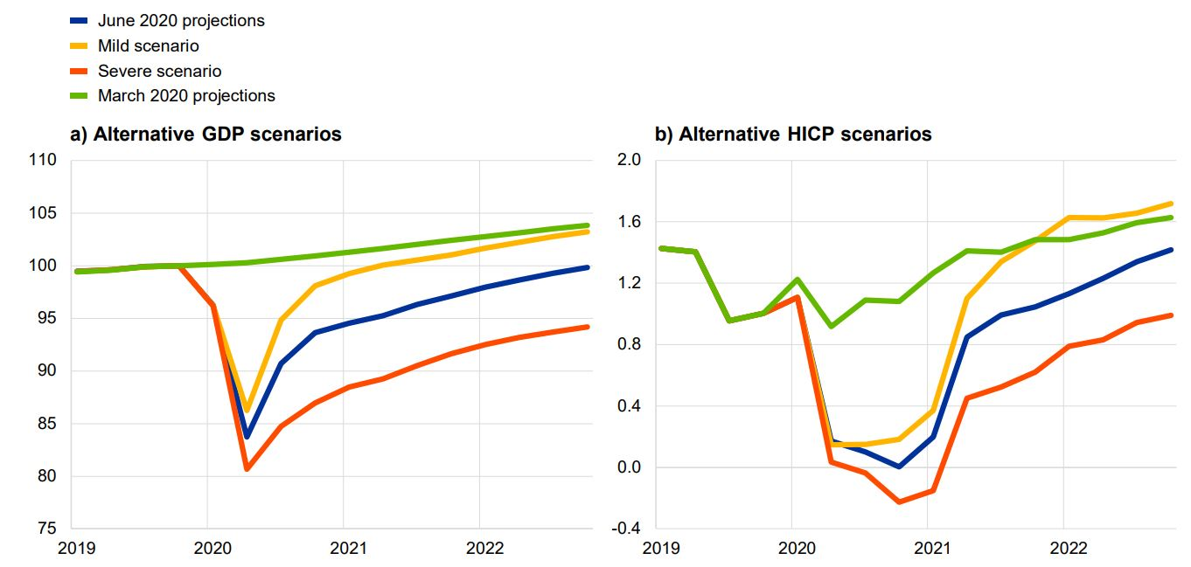
Economic outlook for the euro area
Source: Eurosystem staff macroeconomic projections for the euro area, June 2020.
Note: the left-hand chart uses an index, Q4 2019 = 100. The right hand chart uses year-on-year percentage changes.

Slide 5
June monetary policy decision
Unprecedented downturn in the economy and deterioration in outlook for growth and inflation
Monetary policy action needed to maintain favourable financing conditions for all sectors of the economy and across countries, during crisis and recovery phase.
The Governing Council of the ECB took the following decisions on 4th of June:
  Asset purchases under the Pandemic Emergency Purchase Programme (PEPP) increased by €600bn to €1,350bn.
  The horizon for the asset purchases under PEPP has been extended at least until the end of June 2021.
  Principal payments will be reinvested until the end of 2022.

Slide 6
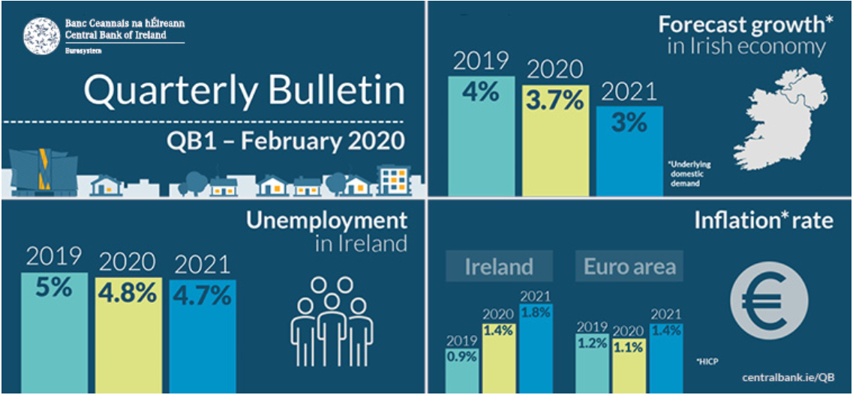
View on Irish Economy – February 2020
Source: Central Bank of Ireland Quarterly Bulletin - Q1 2020

Slide 7
View on Irish Economy – April 2020
Source: Central Bank of Ireland Quarterly Bulletin - Q2 2020

Slide 8
Numbers in receipt of state payments by scheme
Source: CSO, DEASP, Revenue

Slide 9
Business Cycle Indicator (BCI), 2000 - 2020
Source: Measuring Economic Activity in Real Time, Conefrey and Walsh (2020)

Slide 10
Effects of different UK withdrawal scenarios on Irish output
Source: Measuring Dealing with Friction: EU-UK Trade and the Irish Economy after Brexit, Conefrey and Walsh (2020)

Slide 11
Market-based finance sector in Ireland
Financial assets by institution type as a multiple of the country's GDP (GNI*) in 2017, selected countries
Source: Financial Stability Board (2019), Global Monitoring Report on Non-Bank Financial Intermediation 2018, Central Statistics Office and Central Bank of Ireland staff calculations.

