Slide 1

Digital Operational Resilience Act (DORA)
Register of Information (RoI) Collection 2026 Industry Briefing
4 February 2026

Slide 2

Welcome
DORA Registers of Information (RoI) - Central Bank of Ireland collection 2026

Slide 3
Objectives & Agenda
Objectives
Expectations for the 2026 RoI collection
Highlight key updates since last year
Support accurate and timely submissions
Agenda
2025 collection – summary
2026 updates
Timelines & process
File structure & common errors
Support & guidance

Slide 4
The Register of Information – purpose and value
Register of Information (RoI) is a key supervisory tool as well as a risk management tool for FEs
DORA strengthens digital operational resilience
Data quality and consistency are critical
Focus today: Practical execution

Slide 5



2025 RoI Collection Recap
DORA Registers of Information – EBA transmission and validation – 2025 summary
Agenda
Strong industry engagement and collaboration with the Central Bank
410 submitting to CBI
293 (71%)
fully complete
12 with only LEI/ EU-ID errors
26% with failed feedback files
Agenda
Majority of financial entities submitted successfully
Entity type | Fully Complete - in EBA, no DQ errors | Integrated in EBA with DQ errors (Total / sectoral %)
MiFID | 77.5% | 5%
Retail Intermediaries | 33.4% | 22.2%
Insurance | 88% | 1.5%
Banking/ Retail SIs
Payment Institutions | 71.4% | 4.7%
AISPs | 100%
E-Money Institutions | 66.7%
Managers of AIFs | 52%) | 2%
Management Companies | 55.7% | 3%
Trading Venues | 100%
International Bank LSIs | 71.4%
Total / % 410 | 293 (71%) | 12 (3%)
Agenda
Resubmissions were common

Slide 6




2025 Challenges Observed
Agenda
File structure issues
Agenda
Missing or invalid identifiers
Agenda
Referential integrity errors
Agenda
Late Submissions

Slide 7
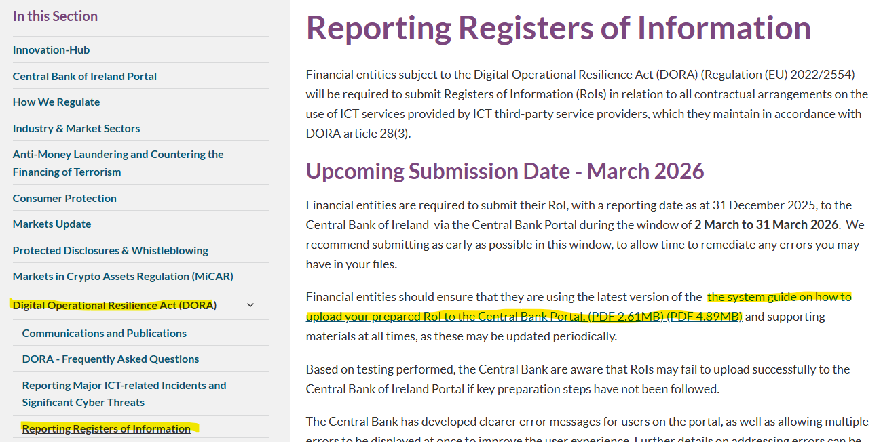
2026 RoI submissions
Key Message
No change to core EBA data model
One small change in EBA Filing Rules
No changes to overall RoI file structure
Submit early in the submission window
2026 – What’s New?
4 day submission window now 4 weeks
Enhanced portal error messages
Clearer validation feedback
Updated and consolidated guidance
https://www.centralbank.ie/regulation/digital-operational-resilience-act-dora/reporting-registers-of-information

Slide 8
2026 RoI Submission timelines
01 March 2026
01 March – 31 March
01 March – 31 March
31 March 2026
Financial Entities upload to the Central Bank Portal
First point of contact for regulatory questions is supervisory team.
Contact the online returns team for technical issues with the portal.
Remediate any errors on Central bank Portal and in EBA Feedback Files and resubmit
Central Bank Portal opens for submissions
Submission Deadline

Slide 9
RoI File Structure

Slide 10
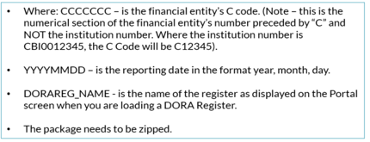
Reminder of the file structure
META-INF
ReportPackage.json
Report.json
CCCCCCC_YYYYMMDD_DORAREG_NAME
Parameters.csv
Reports
FilingIndicators.csv
{table}.csv

Slide 11

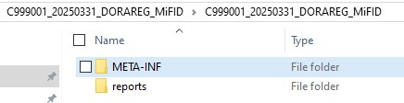
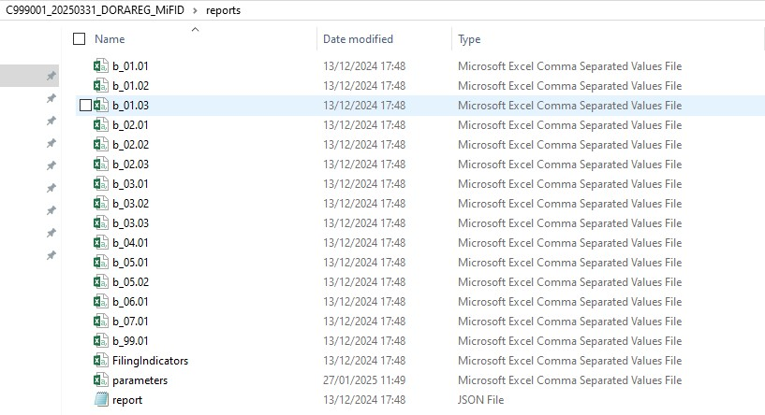
Sample file structure – high level zip file and root folder

Slide 12
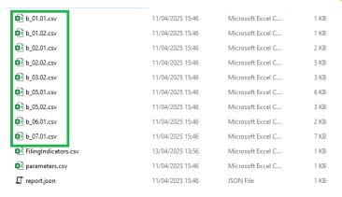
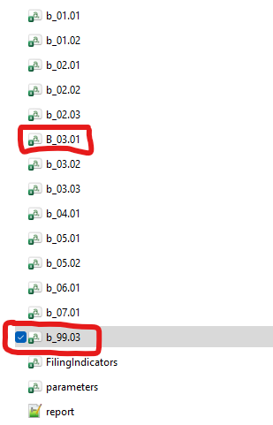
Sample file structure – META-INF and Reports
reportPackage is a .json file
Accepted
Files are saved with a small b_xx.xx format in the Reports folder
Rejected
report is also a .json file

Slide 13
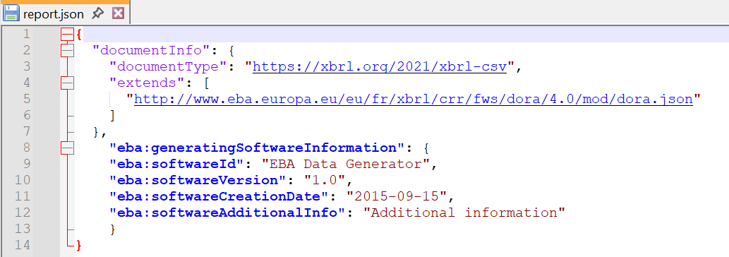
Sample file structure - .json files
The content of the reportPackage file has not changed since the last submission
The generatingSoftwareInformation element is new since last year in the new EBA filing rules v5.7

Slide 14
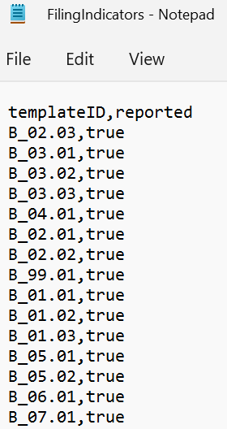
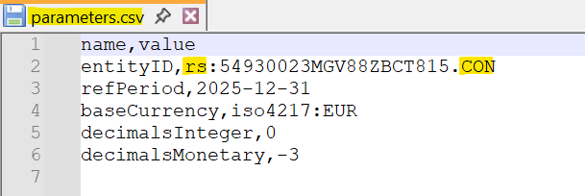
Sample file structure - FilingIndicators
FilingIndicators file has marked all files as “true” and files are noted with a capital B_xx.xx (both are case sensitive)
Reminder:
Edit files in Notepad/ your security-approved editor, but not in Excel
Parameters file should contain a LEI and not CNUM
have rs: in front of the LEI number
have ‘.CON’ or ‘.IND’ after your
LEI code
date format within the files is
YYYY-MM-DD.
No Symbols e.g. no €

Slide 15
Common 2025 errors to avoid

Slide 16
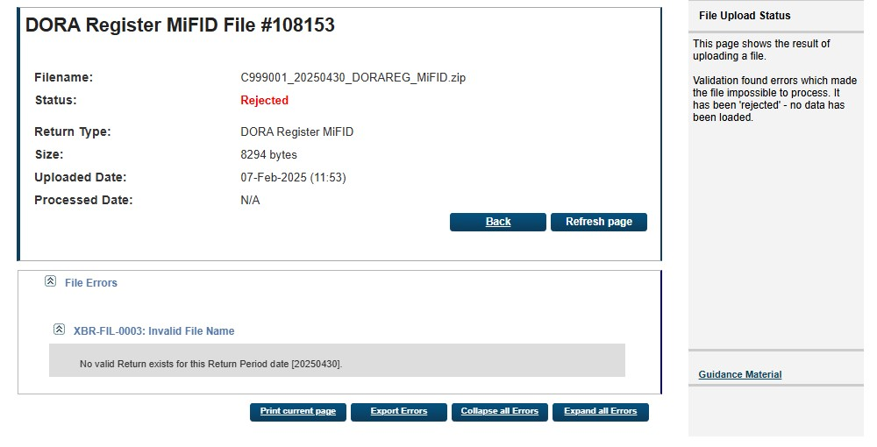
Filename for zip file being loaded to central bank portal
Error
Solution
Ensure the reporting date in the filename of the zip package is correct
Save the file with a reporting date as follows:
C999001_20251231_DORAREG_MiFiD.zip

Slide 17
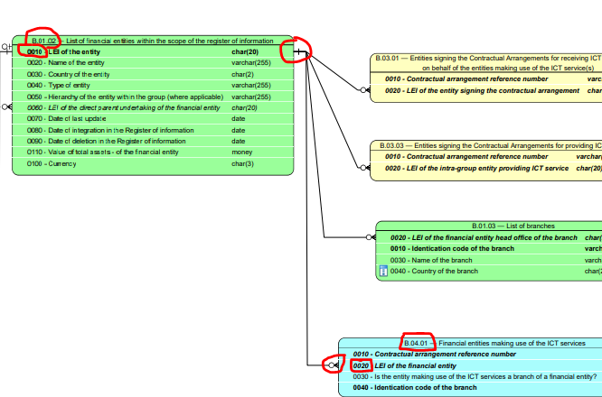
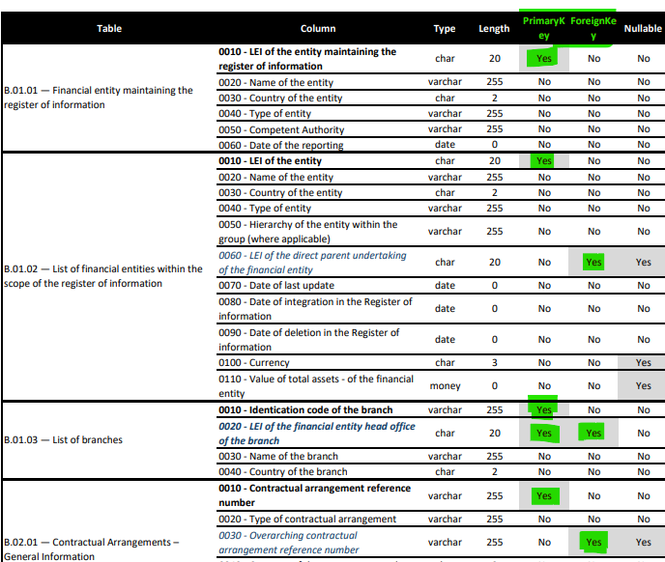
Referential integrity errors
Error
Data integrity as per EBA Data model.
The EBA data model shows the required links between values in each workbook. For example the values in column B_04.01 c0020 should come from B_01.02, c0010, as shown in the data model on the right.

Slide 18
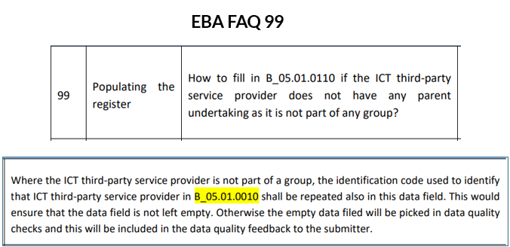
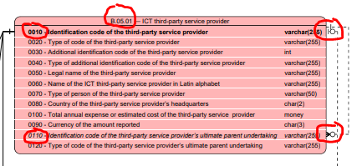
Referential integrity errors
Error
B_05.01, c0110 - the Implementing Regulation (EU) 2024/2956 (the ITS)) requires ultimate parent undertakings reported in c0110 to be reported in B_05.01 as separate rows.
If the provider in c0010 is the ultimate parent, you should repeat the same ID in c0110 as in c0010.
If a value different from c0010 is present for the ultimate parent in B_05.01.0110, it should be reported in c0010 as a separate entry (row).

Slide 19
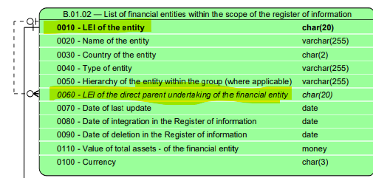
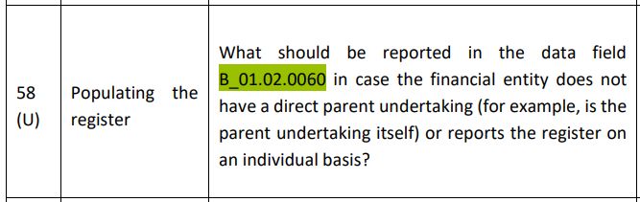
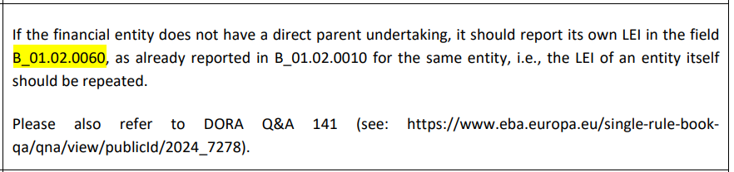
Referential integrity errors
Error
B_01.02, c0060 –
The parent reported in C0060 in this template also has to be reported in B_01.02 (the same template) as a separate row and have the same code (from c0060) in B_01.02.0010.
Per the EBA FAQ, If the financial entity does not have a direct parent undertaking, it should report its own LEI in the field B_01.02.0060, as already reported in B_01.02.0010 for the same entity, i.e., the LEI of an entity itself should be repeated.
EBA FAQ 58

Slide 20
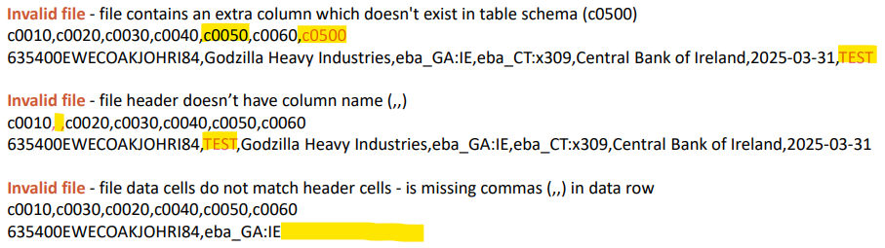
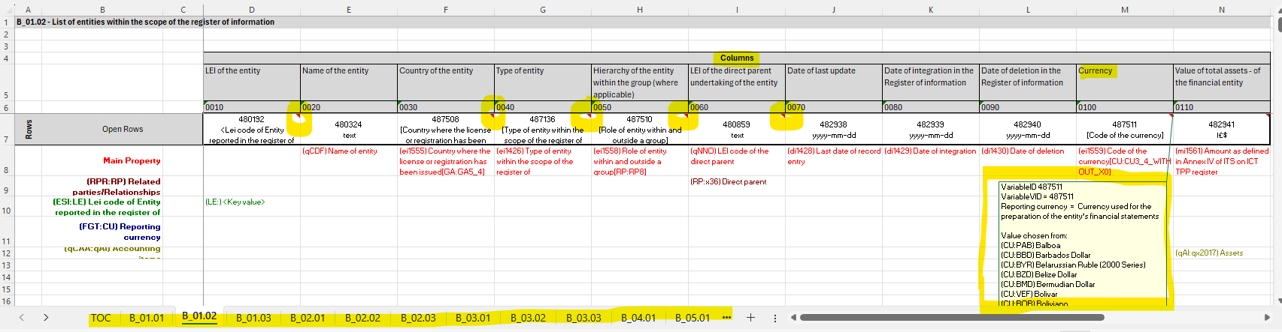
Extra columns or extra rows within templates
The ITS, the Data Model and the Annotated Template are all sources of information for what data should be included in each template and in which column, and how many columns there should be.
Examples of errors::
Sample template viewed in Notepad ++:
Annotated File

Slide 21
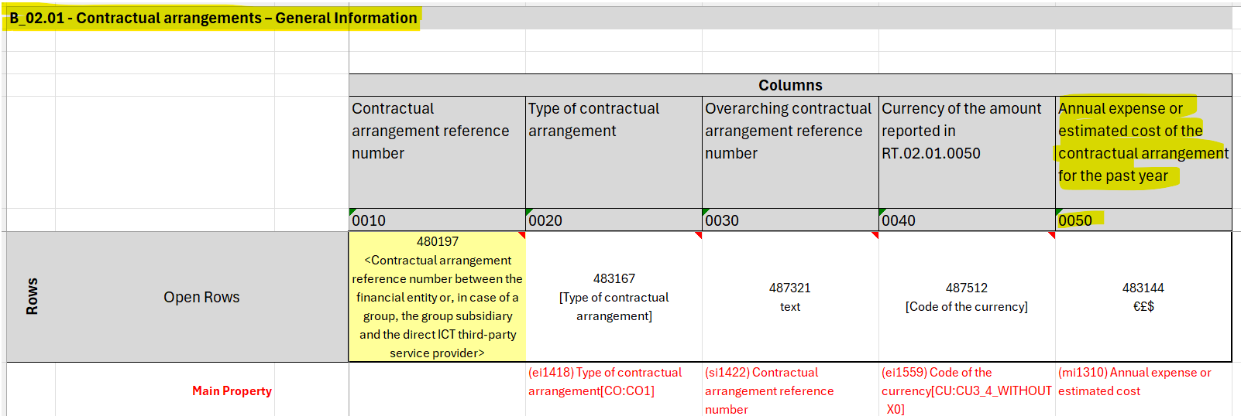
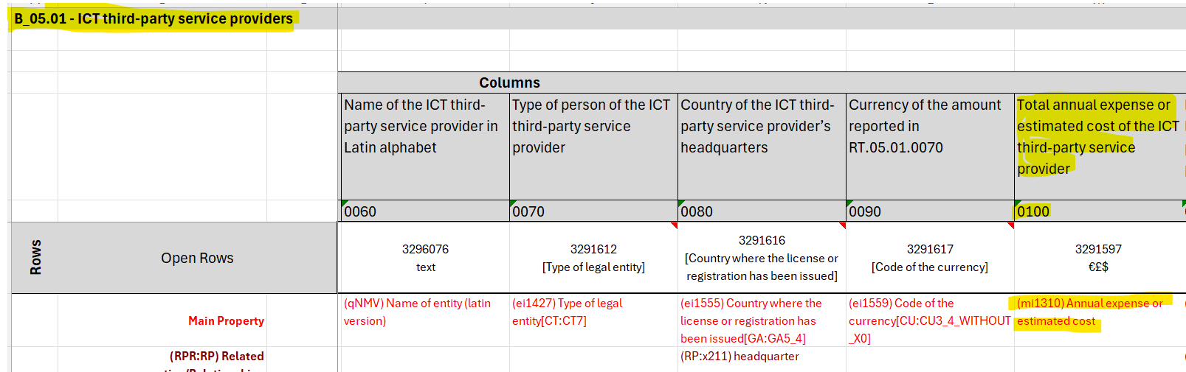
Budget consistency – data quality check
The total sum of budget should be the same between 02.01.0050 and 05.01.0100.
B_02.01 c0050 – annual expense or estimated cost of contractual arrangement for past year
B_05.01 c0100 – annual expense or estimated cost of contractual arrangement for past year

Slide 22
Common 2025 errors
Non-Exhaustive list of useful checks
Ensure the file name and reporting date is correct
Ensure that the Financial Entity’s LEI is correct and is in upper case.
Ensure the LEI and C-Code are correct and are aligned – that the C code is for the entity with the reported LEI in the parameters file.
Ensure that the same return for the same reporting date is not already signed off.
Ensure the date formats within files is correct (YYYY-MM-DD)
Ensure the file has a parameters file.
Ensure the LEI is correctly populated in the parameters file.
Ensure the files are not empty (unless permitted by Data Model/ ITS)
Ensure the file has a FilingIndicators.csv file.
Ensure the file has the appropriate JSON files.
Ensure the file is not double zipped.
Ensure you do not have any currency symbols within your file (€£$)
Ensure your column headers are correct and that your rows contain the correct number of columns
Ensure you use valid drop-down values where required
Ensure you have values in the primary key fields in all templates
*Further information can be found in the Central Bank Guidance document available on our DORA website

Slide 23
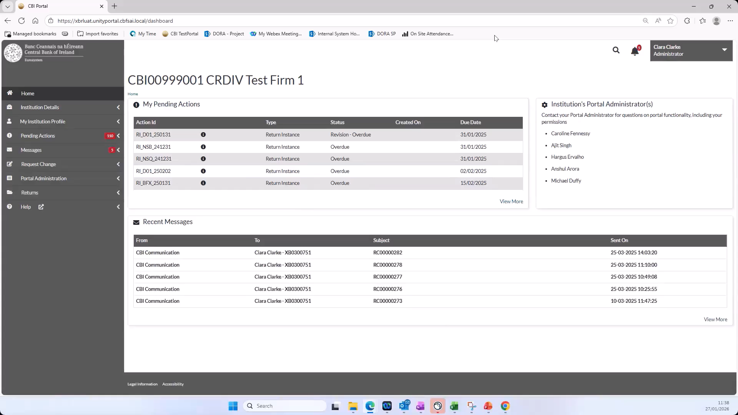
Uploading the RoI

Slide 24
Examples of 2026 enhancements on the Central Bank Portal

Slide 25



Improvements made based on feedback from 2025
Agenda
More validations have been implemented
Agenda
Error messages are more specific
Agenda
More than one error will appear at a time
Agenda
Consolidated Guidance

Slide 26
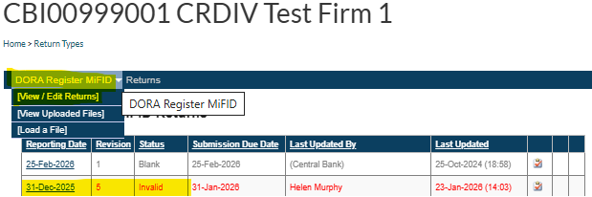
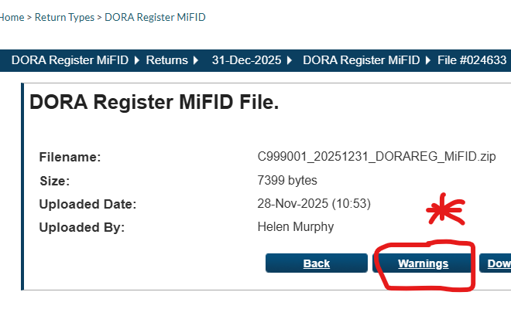
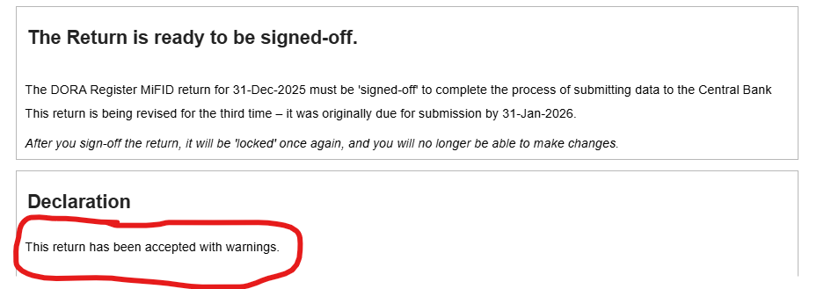
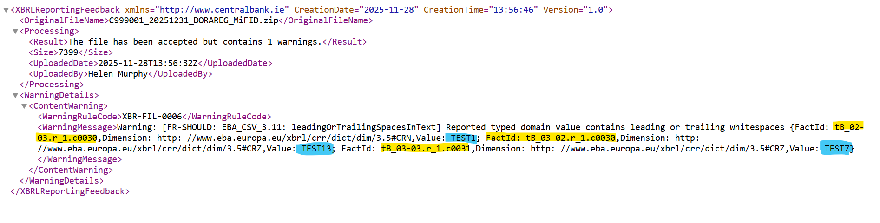
Additional Validations implemented on the Central Bank Portal
Warning errors
Warning errors will alert you to EBA Filing rule issues within your file
Error specifically notes value “ TEST1”
in table b_03.02 r1, c0030 contains leading or trailing whitespaces
Error generated

Slide 27


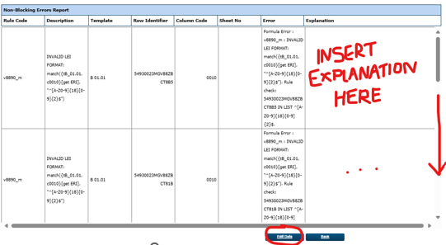
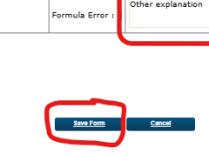
Additional Validations implemented on the Central Bank Portal – LEI checks
Non-blocking errors
Non-blocking errors will alert you to potential issues within your file
Click on the reporting date link for the ‘Invalid’ file
There are a number of templates within your register which contain LEI codes.
These codes should match a defined syntax with a set mix of alphanumeric characters.
LEIs should also be valid per the GLEIF and in B_01.02, c0030, the country code in column c0030 should match the registered country in the GLEIF .
Description says ‘Invalid LEI format’ {tB_01.01 c0010} …

Slide 28
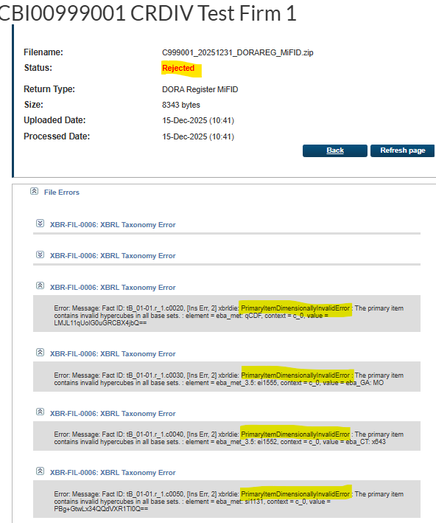
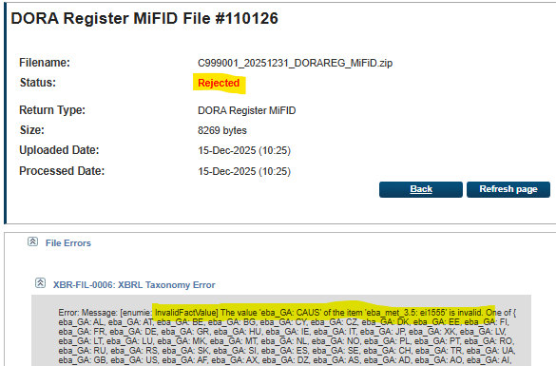


Error enhancements on the Central Bank Portal – More than one error at a time
Multiple errors
Once the file structure is correct, other errors will appear together –not just one at a time
Missing Key Values
“PrimaryItemDimensionally
InvalidError : The primary item contains invalid hypercubes in all base sets”
Invalid values in drop down fields

Slide 29
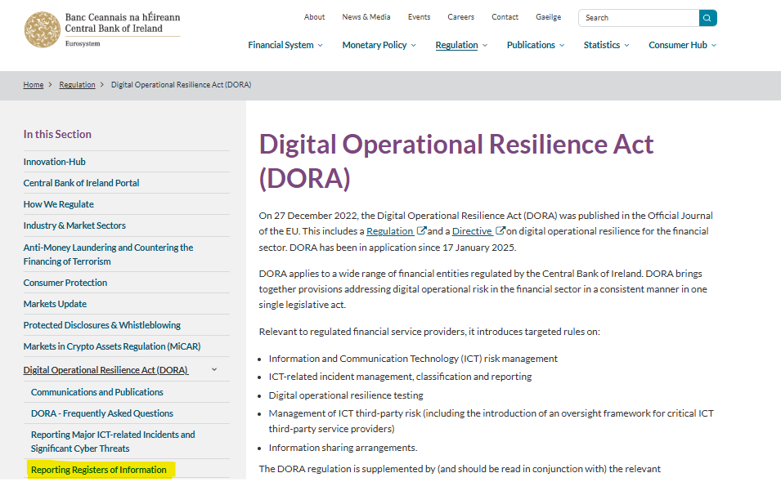
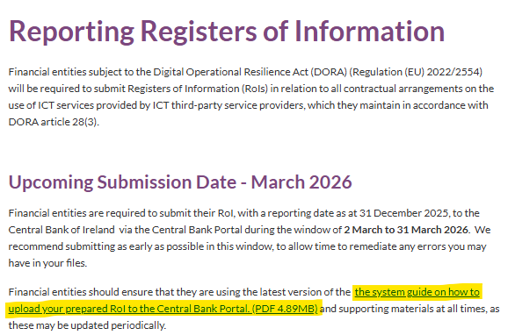
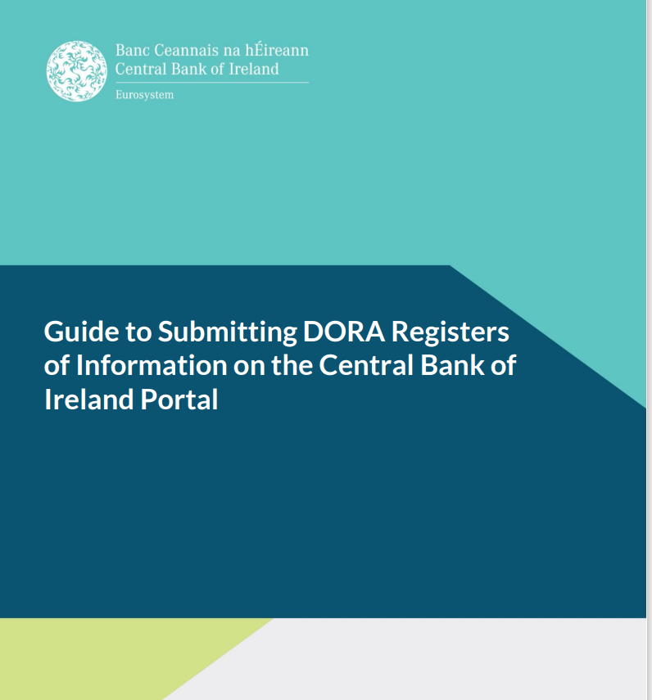
Central Bank Guidance consolidated
Updated Central Bank DORA website and consolidated guidance document
https://www.centralbank.ie/regulation/digital-operational-resilience-act-dora
The updated guidance document contains guidance on updated Central Bank Portal errors as well as links to the EBA guidance mentioned throughout this webinar.

Slide 30
Final Summary

Slide 31

Key Takeaways
Prepare to submit early (1 March– 31 March)
Validate file structure thoroughly
Pay particular attention to referential integrity
Use the updated guidance
Support: Engage with supervisors and online returns

Slide 32




Next Steps
Agenda
Review the updated guidance
Finalise your register package
Plan internal governance/ assign roles for register upload and sign-off
Monitor communications on the Central Bank DORA website

Slide 33
Guidance and Resources
Agenda
Central Bank Guidance document
Central Bank DORA register website
EBA register preparation site
EBA slides on preparing the DORA Register
EBA data model
EBA annotated template

Slide 34
Thank You

